Slide 1
PROCESS DEADLOCKS
CHAPTER 4

Slide 2
System model

Slide 3
Introduction to deadlock
Consider an example when two trains are coming towards each other on same track and there is only one track none of the train can move once they are in front of each other similar situation. Occurs in operating system, when there are two or more process hold some resource and wait for resources held by other.
Process 1 is holding Resource 1 and waiting for resource 2 which is acquired by process 2, and process 2 is waiting for resource 1.

Slide 4
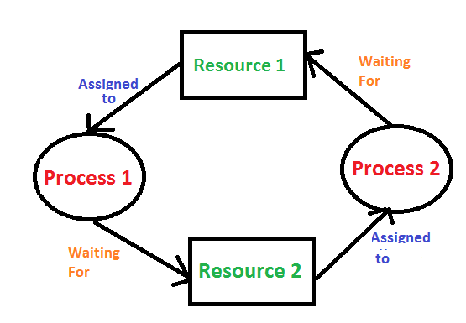

Slide 5
deadlocks characterization (CONDITION for resource deadlocks)
1.mutual exclusion condition:- The resources involved are non-shareable, At least one resource must be held in a non-shareable mode.
2.Hold and wait condition:-According to this condition, A process is holding atleast one resource and is waiting for additional resources.
3.Non-preemptive condition:- Resources cannot be taken from the process because resources can be released only voluntarily by the process holding them.
4 circular wait condition:-In this condition, the set of processes are waiting for each other in the circular form.

Slide 6
Method of handling deadlocks
1. Deadlock ignorance (The ostrich Algorithm)
What ostrich algorithm says?
Stick your head in the sand and pretend that there is no problem

Slide 7
2.Deadlock Prevention
As we have discussed in the above , that all four conditions: Mutual Exclusion, Hold and Wait, No preemption, and circular wait if held by a system then causes deadlock to occur. The main aim of the deadlock prevention method is to violate any one condition among the four; because if any of one condition is violated then the problem of deadlock will never occur. As the idea behind this method is simple but the difficulty can occur during the physical implementation of this method in the system

Slide 8
3.DeadlockAvoidance(Banker's Algorithm)
This method is used by the operating system in order to check whether the system is in a safe state or in an unsafe state. This method checks every step performed by the operating system. Any process continues its execution until the system is in a safe state. Once the system enters into an unsafe state, the operating system has to take a step back

Slide 9
Banker's Algorithm
Banker’s algorithm is named so because it is used in banking system to check whether loan can be sanctioned to a person or not. Suppose there are n number of account holders in a bank and the total sum of their money is S. If a person applies for a loan then the bank first subtracts the loan amount from the total money that bank has and if the remaining amount is greater than S then only the loan is sanctioned. It is done because if all the account holders comes to withdraw their money then the bank can easily do it.

Slide 10
Deadlock detection and recovery
In this approach, The OS doesn't apply any mechanism to avoid or prevent the deadlocks. Therefore the system considers that the deadlock will definitely occur. In order to get rid of deadlocks, The OS periodically checks the system for any deadlock. In case, it finds any of the deadlock then the OS will recover the system using some recovery techniques.
The main task of the OS is detecting the deadlocks. The OS can detect the deadlocks with the help of Resource allocation graph.

